Slide 1

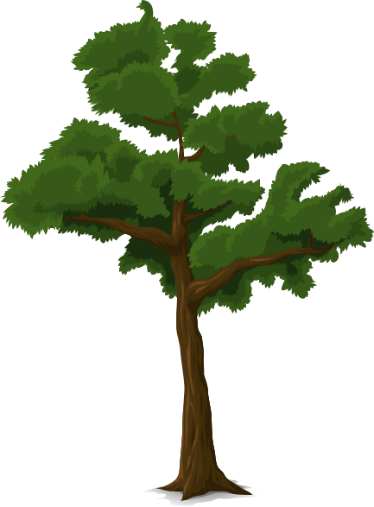
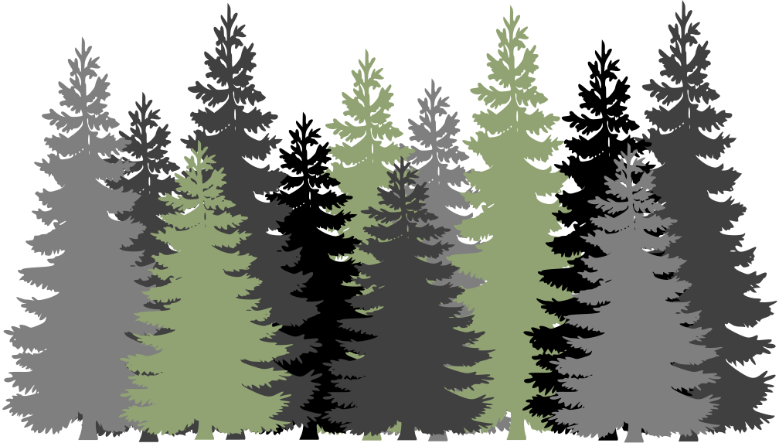

FOREST COVER TYPE PREDICTION
~A Classification Problem
Group Members :
Batchu Heam chandu
S Esha Yadav
Yash Vardhan Khetawat
Mamidi Reshma
V.Sriram
Vishnu Vamsi

Slide 2
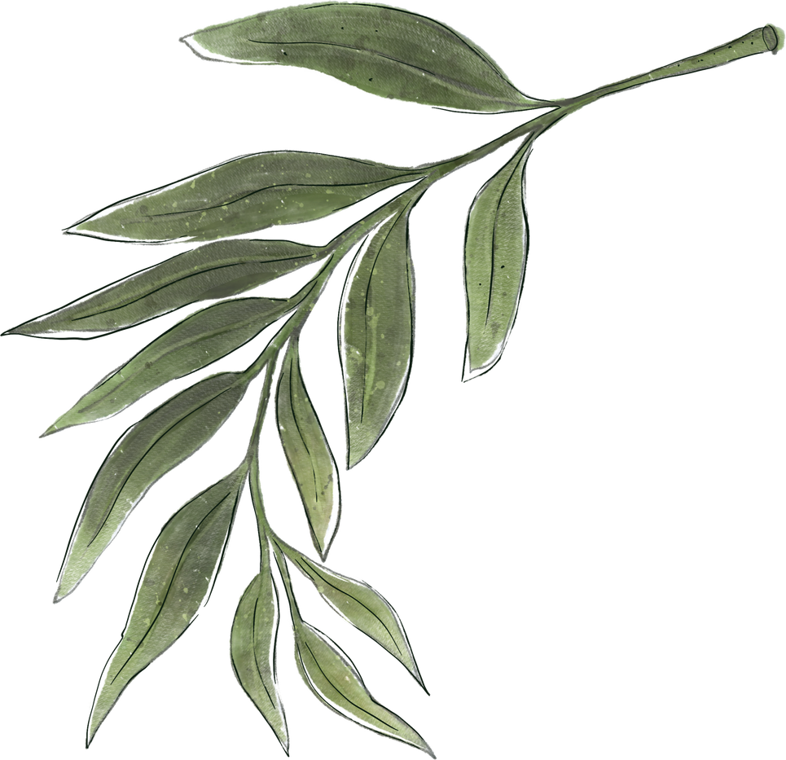

TABLE OF CONTENTS
1
5
INTRODUCTION & PROBLEM STATEMENT
OUTLIER TREATMENT
2
6
MODEL BUILDING
DATA SET
3
UNIVARIATE & BIVARIATE
7
FEATURE IMPORTANCE
4
8
SCALING
CONCLUSION

Slide 3

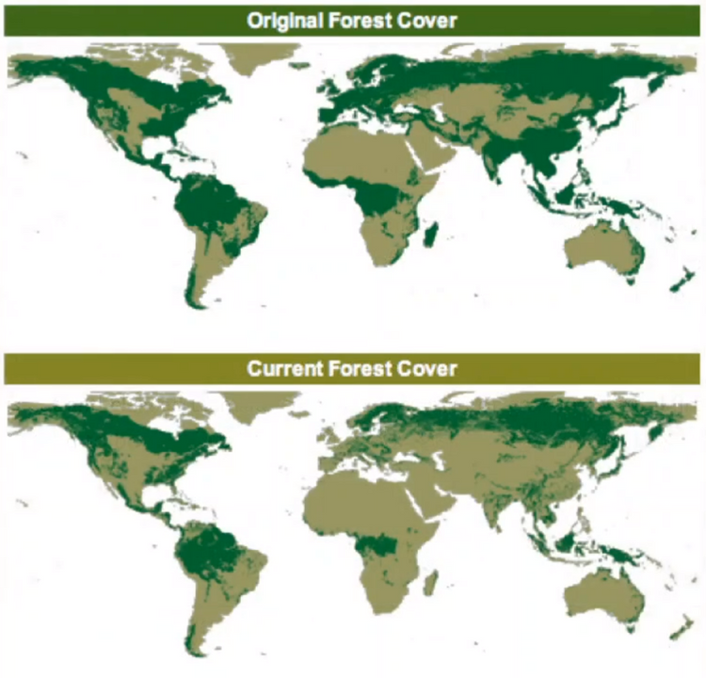
INTRODUCTION:
Trees are vital. They give us oxygen, store carbon, stabilise the soil and give life to the world’s wildlife. They also provide us with the materials for tools and shelter. The canopies of trees act as a physical filter like trapping dust and absorbing pollutants from the air. They also provide shade from solar radiation and reduce noise.
......BUT,
In the past 25 years, forests shrank by 502,000 square miles (1.3 million square km) — an area bigger than the size of South Africa. 18.3 billon trees are cut down per year. That means for every second 483 trees are cut down worldwide,which means football ground size forest lost for every single second around the clock.

Slide 4

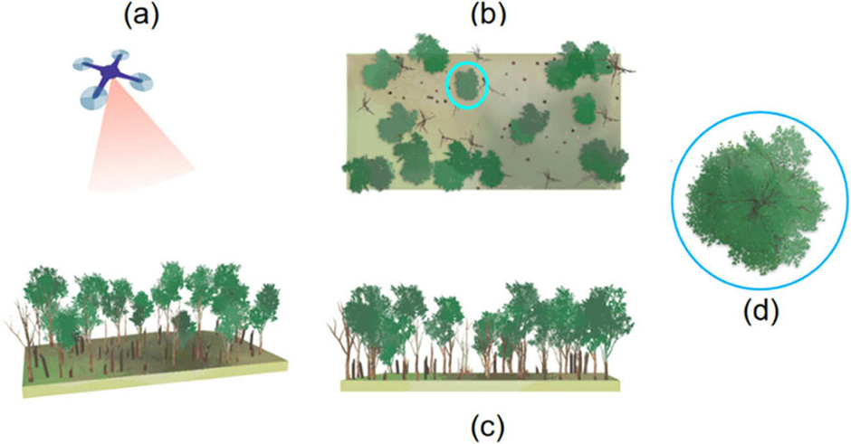
BUSINESS PERCEPTIVE:
The idea of this project is creating drones, which will monitor the situation with trees in general. so, that it makes a report which trees are growing in area based on the surrounding characteristics. Eventually, system will use that information for making report and inform appropriate workers and instance.

Slide 5

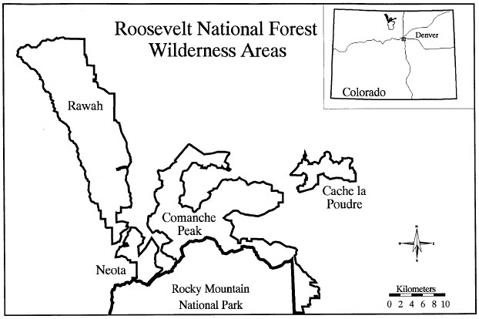
THE PROBLEM STATEMENT
Predict the forest cover type (the predominate kind of trees cover) the strictly cartographic variables. This area divided each 30 m x 30 m cell in the Roosevelt National Forest of northern Colorado with 7 cover types in 4 wilderness area.
7 COVER TYPES :
1 - SPRUCE/FIR
2 - LODGEPOLE PINE
3 - PONDEROSA PINE
4 - COTTONWOOD/WILLOW
5 - ASPEN
6 - DOUGLAS-FIR
7 - KRUMMHOLZ

Slide 6
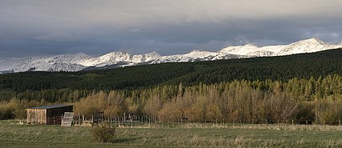



THE DATA SET
The study area includes four wilderness areas located in the Roosevelt National Forest of northern Colorado. These areas represent forests with minimal human-caused disturbances, so that existing forest cover types are more a result of ecological processes rather than forest management practices.

Slide 7

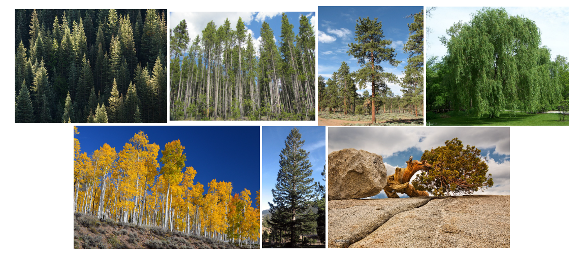
7 COVER TYPES
SPRUCE/FIR
LODGEPOLE PINE
PONDEROSA PINE
COTTONWOOD/WILLOW
ASPEN
DOUGLAS-FIR
KRUMMHOLZ

Slide 8
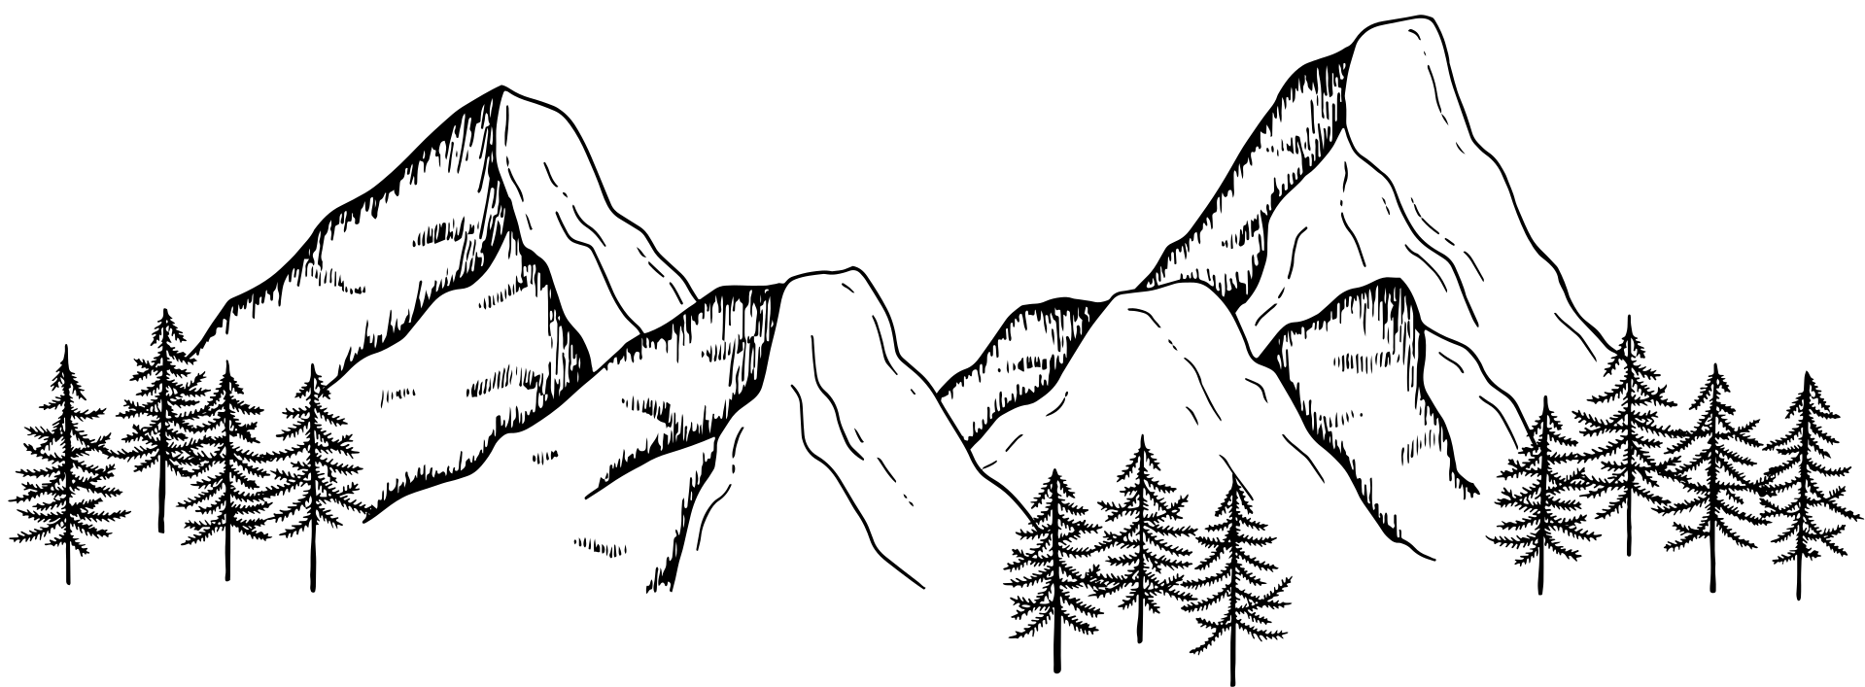
DATA EXPLORATION
ELEVATION
ASPECT
SLOPE
HORIZONTAL_DISTANCE_TO_HYDROLOGY
VERTICAL_DISTANCE_TO_HYDROLOGY
HORIZONTAL_DISTANCE_TO_ROADWAYS
HILLSHADE_9AM
HILLSHADE_NOON
HILLSHADE_3PM
HORIZONTAL_DISTANCE_TO_FIRE_POINTS
WILDERNESS_AREA (4)
SOIL TYPES (40)
COVER TYPES (7)

Slide 9
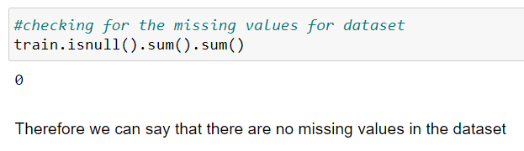

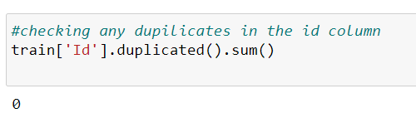
DATA PREPROCESSING
The dataset is complete, and there are no missing values.
We removed the ID column from the dataset.

Slide 10
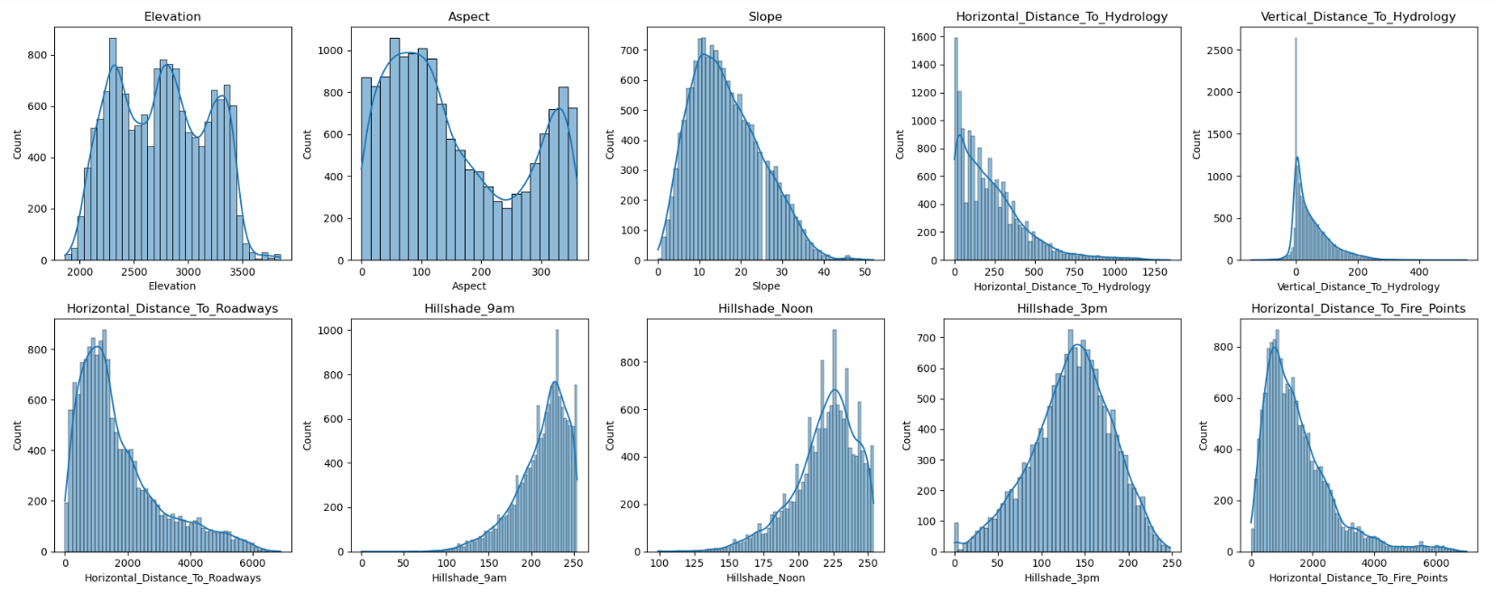
UNIVARIATE ANALYSIS

Slide 11
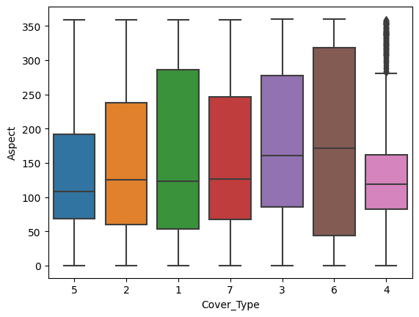
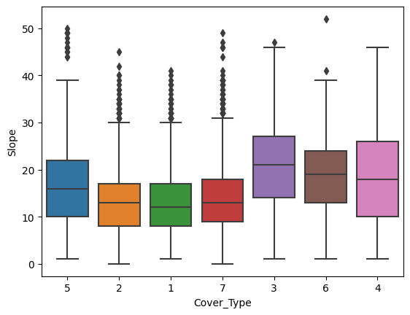
BIVARIATE ANALYSIS
Relationship between Aspect and Cover Type
Relationship between slope and Cover Type
1. The distribution is not normal.
2. There is a wide dispersion in cover types 1 and 6.
3. Overlapping medians are observed for certain cover types.
4. Outliers are present in cover type 4.
1. The distribution of slope is nearly normal but exhibits a slight right skew.
2. Slope values are distributed across different cover types.
3. Outliers are noticeable within cover types 1, 2, 5, and 7.

Slide 12
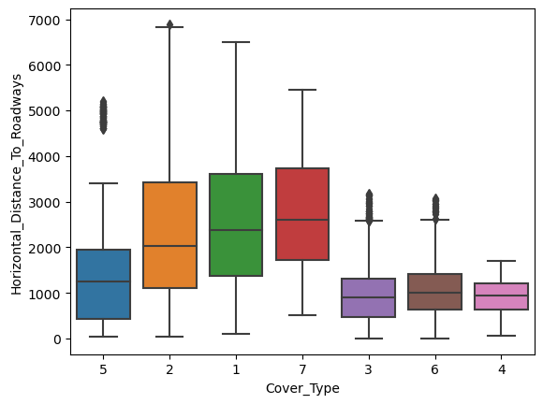

Slide 13
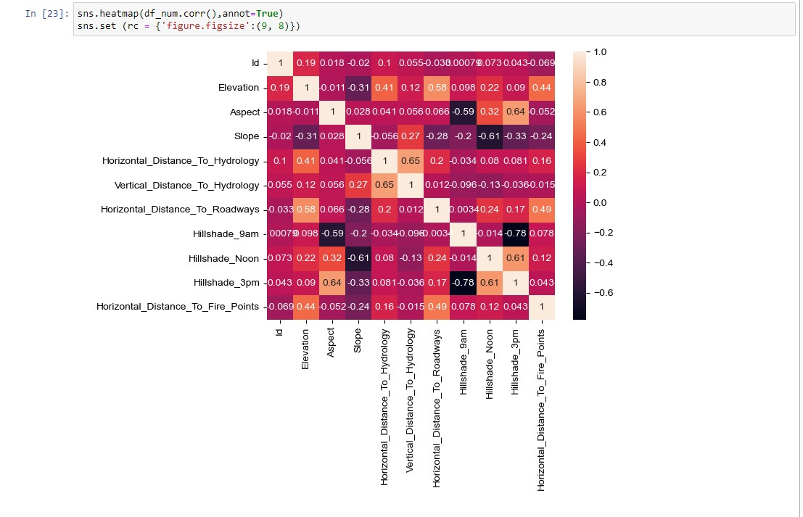
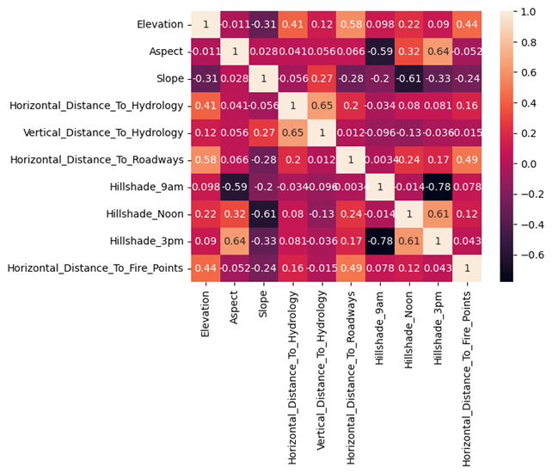

HEAT MAP
1. Hillshade3pm and Hillshade9am:
When Hillshade3pm is high, Hillshade9am tends to be low, and vice versa.
They have a strong inverse relationship with a correlation of -0.78.
2. Hillshade3pm and Aspect:
When Hillshade3pm values go up, Aspect values also tend to go up.
They have a moderate positive relationship with a correlation of 0.64.
3. Vertical and Horizontal Distance to Hydrology :
When Vertical Distance to Hydrology increases, Horizontal Distance to Hydrology also tends to increase.
They have a moderate positive relationship with a correlation of 0.65.

Slide 14
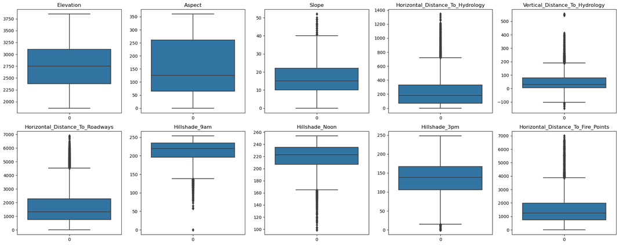
IDENTIFYING OUTLIERS:
The boxplots reveal the presence of outliers in specific columns, namely 'Horizontal_Distance_To_Hydrology’,
'Vertical_Distance_To_Hydrology,' 'Horizontal_Distance_To_Roadways,' 'Hillshade_9am,' 'Hillshade_Noon,'
'Horizontal_Distance_To_Fire_Points.'

Slide 15




MODELS(ACCURACY) WITHOUT OUTLIER TREATMENT :-
Random Forest
Decision Tree
SUPPORT VECTOR MACHINES(SVM )
KNN

Slide 16
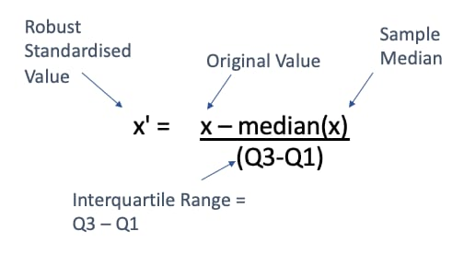

ROBUST SCALER
Robust scaling in our project involves transforming the data using the Interquartile Range (IQR), which is the range between the first and third quartiles. This method minimizes the impact of outliers on the scaling process, ensuring a more robust representation of the dataset.

Slide 17

K-NEAREST NEIGHBORS
Imputation Technique:
KNN Imputer is a method used to fill in missing values in the dataset by considering the values of its nearest neighbors.
It estimates missing values based on the characteristics of similar data points.
Nearest Neighbors Consideration:
The imputation process involves calculating distances between data points to identify the k-nearest neighbors for each missing value.
The value of "k" (number of neighbors) is a crucial parameter that influences the imputation accuracy.

Slide 18
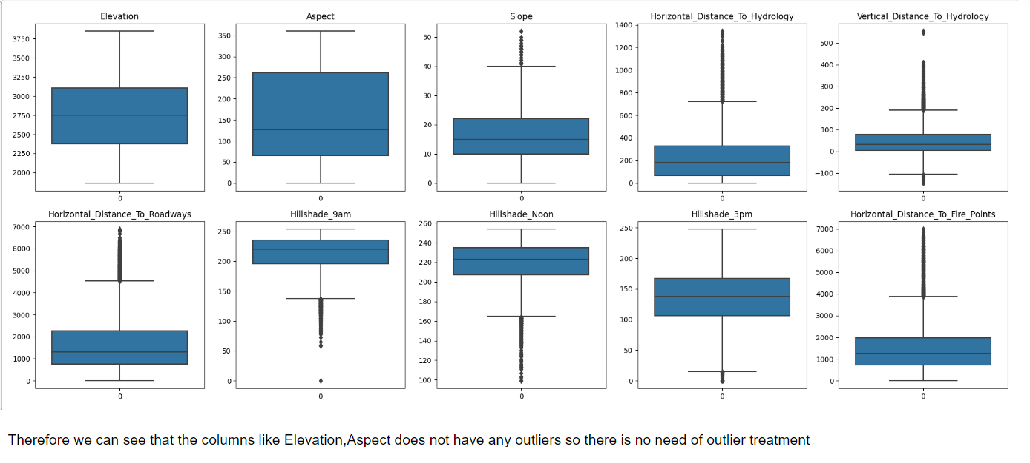
OUTLIER TREATMENT
We performed outlier treatment using the KNN imputer method, specifically addressing variables where the mean and median values differed significantly. This approach helps improve the accuracy of our data by predicting missing or outlier values based on the distances to the k-nearest neighbors, ensuring a more robust estimation of the data distribution.

Slide 19
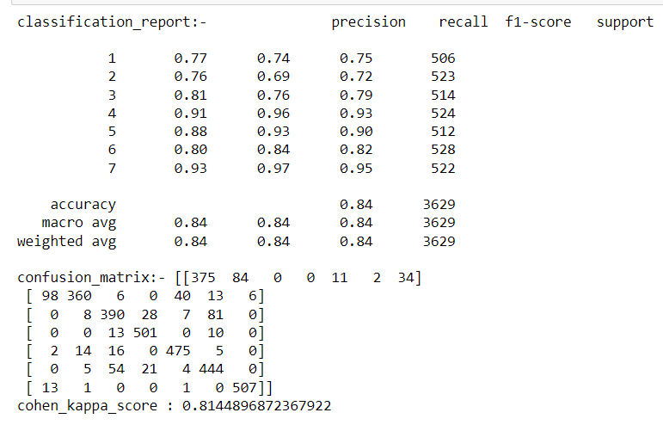
RANDOM FOREST
Accuracy: 84%
Consistent Performance: Strong precision and recall for all cover types.
Outstanding Performance: Class 4 – 92% precision, 98% recall.
Overall: More reliable and accurate compared to the Decision Tree model.

Slide 20





BASE MODELS(ACCURACY):-
DECISION TREES
RANDOM FOREST
MULTINOMIAL LOGISTIC REGRESSION
K-NEAREST
NEIGHBORS
LINEAR DISCRIMINANT
ANALYSIS
SUPPORT VECTOR
MACHINE

Slide 21






BASE MODELS(ACCURACY) FOR TRAINING:-
DECISION TREES
RANDOM FOREST
MULTINOMIAL LOGISTIC REGRESSION
K-NEAREST
NEIGHBORS
LINEAR DISCRIMINANT
ANALYSIS
SUPPORT VECTOR
MACHINE

Slide 22

CHOOSING OF BEST BASE MODEL
The provided information describes the performance of the different machine learning models: Decision Tree, Random Forest, and k-Nearest Neighbors (KNN).
Decision Tree (Accuracy: 76%): The Decision Tree model achieved an accuracy of 76%.
Random Forest (Accuracy: 84%): The Random Forest model outperformed the Decision Tree, exhibiting a higher accuracy of 84%. Additionally, it showed consistent excellence across precision, recall, and F1-scores. This suggests that Random Forest provides a more robust and reliable prediction, making it a favorable choice compared to the Decision Tree.
we can infer that the Random Forest model outperformed the Decision Tree and k-Nearest Neighbors models in terms of accuracy, precision, recall, and F1-scores. The Random Forest model achieved an accuracy of 84% and demonstrated consistent excellence across various performance metrics.
Therefore, from the models evaluated, the Random Forest appears to be a better choice for the specific task or application at hand.

Slide 23


POWER TRANSFORMER:
The use of the Yeo-Johnson power transformer over Box-Cox is justified for the given models due to its flexibility with non-positive values, offering a broader range of transformations, and being more robust across different data distributions. Yeo-Johnson's ability to handle a mix of positive and non-positive values makes it suitable for diverse datasets, and its broader range of transformations provides flexibility in capturing different data patterns. Additionally, its robustness across various data distributions aligns well with the unpredictable nature of the models, potentially leading to better performance in different scenarios.

Slide 24
HYPERPARAMETER TUNING
Hyperparameter tuning optimizes machine learning model performance by systematically adjusting configuration settings not learned from data.Random Forest appears to be the most accurate among the models. However, the choice of the best model depends on the specific requirements and characteristics of the application, and further exploration, including hyperparameter tuning, could optimize the performance of each model.
The best parameters for each model, hyperparameter tuning is typically conducted through techniques like grid search or randomized search Randomized Search CV is a suitable choice for optimizing hyperparameters efficiently. Continue utilizing it for each model to enhance their performance, considering the unique characteristics and requirements of each algorithm.

Slide 25



TUNED MODELS(ACCURACY) :-
K-NEAREST
NEIGHBORS
DECISION TREES
RANDOM FOREST
LINEAR DISCRIMINANT
ANALYSIS
SUPPORT VECTOR
MACHINE

Slide 26




TUNED MODELS(ACCURACY) FOR TRAINING :-
K-NEAREST
NEIGHBORS
DECISION TREES
RANDOM FOREST
LINEAR DISCRIMINANT
ANALYSIS
SUPPORT VECTOR
MACHINE

Slide 27
EVEN AFTER EMPLOYING PRUNING TECHNIQUES TO MITIGATE OVERFITTING BY REDUCING LEAF NODES AND THEIR DEPTH, THE MODEL'S PERFORMANCE ON THE TESTING SET REMAINS AT 81%, COMPARED TO A HIGH TRAINING SET ACCURACY OF 98%. DESPITE THE EFFORT TO OPTIMIZE THROUGH PRUNING, THE MARGINAL IMPROVEMENT SUGGESTS CHALLENGES IN ACHIEVING A BETTER BALANCE BETWEEN MODEL COMPLEXITY AND GENERALIZATION. CONSEQUENTLY, THESE RESULTS LEAD US TO DESIGNATE THIS MODEL, POST-PRUNING, AS OUR FINAL ITERATION. ONGOING MONITORING AND POTENTIAL EXPLORATION OF ALTERNATIVE APPROACHES MAY BE WARRANTED TO FURTHER ENHANCE ITS STABILITY AND OVERALL PERFORMANCE.

Slide 29
Boosting Techniques used :-
AdaBoost:
Method: Iterative, focus on misclassified.
Strength: Aggregates weak learners.
Application: Good for diverse weak models.
Gradient Boosting:
Process: Sequential tree building.
Strength: Corrects predecessor's errors.
Use Case: Effective on various data types.
XGBoost:
Features: Scalable, parallelized.
Advantage: Handles large datasets efficiently.
Popular: Widely used in competitions.
LightGBM:
Strategy: Leaf-wise tree growth.
Efficiency: Handles large datasets, categorical features.
Useful: Efficient gradient boosting.

Slide 30




BOOSTED MODELS(ACCURACY) :-
XGBOOST
ADABOOST
GRADIENT BOOSTING
LIGHTGBM

Slide 31



BOOSTED MODELS(ACCURACY) FOR TRAINING :-
XGBOOST
ADABOOST
GRADIENT BOOSTING
LIGHTGBM

Slide 32
COMPARING ADABOOST, GRADIENT BOOSTING, AND XGBOOST WITH LIGHTGBM, IT'S OBSERVED THAT XGBOOST AND LIGHTGBM HAVE PROVIDED SUPERIOR RESULTS FOR THE MODEL. THE ENSEMBLE BOOSTING ALGORITHMS, XGBOOST AND LIGHTGBM, DEMONSTRATED ENHANCED PREDICTIVE CAPABILITIES AND OUTPERFORMED ADABOOST AND GRADIENT BOOSTING IN TERMS OF ACCURACY AND GENERALIZATION. THEIR EFFICIENT IMPLEMENTATION OF GRADIENT BOOSTING, REGULARIZATION TECHNIQUES, AND PARALLELIZATION CONTRIBUTE TO FASTER TRAINING AND IMPROVED MODEL PERFORMANCE. THEREFORE, FOR THIS SPECIFIC APPLICATION, THE CHOICE OF XGBOOST OR LIGHTGBM IS RECOMMENDED FOR ACHIEVING BETTER RESULTS AND OVERALL MODEL EFFECTIVENESS.

Slide 33
STACKING
Stacking is an ensemble technique that combines the predictions of multiple base models to create a more robust and accurate model.
The idea behind stacking is to train a model to make predictions based on the outputs of several individual base models.
Stacking is powerful because it leverages the strengths of different base models and reduces their individual weaknesses

Slide 34


STACKED MODEL(ACCURACY) :-
TRAINING SET
TESTING SET

Slide 35
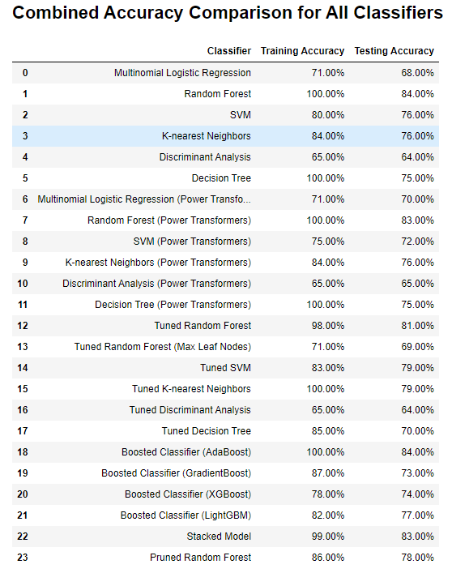

Slide 36
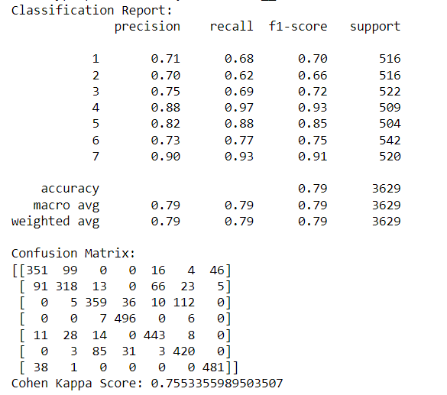
FINAL MODEL :-
The Tuned Support Vector Machine (SVM) model achieves a testing accuracy of 79.00%, striking a balance between simplicity and predictive power. While it demonstrates good generalization to new data, it's essential to acknowledge a slight drop in accuracy compared to the training set. Overall, the tuned model offers a reliable and interpretable solution, suitable for scenarios prioritizing transparency and performance on unseen instances. Regular monitoring is advised for sustained effectiveness in real-world applications.

Slide 37
FEATURE IMPORTANCE :-
The feature importance analysis reveals that certain environmental and geographical attributes play a crucial role in influencing the predictions of the tuned SVM model. The top 10 important features include 'Elevation,' 'Horizontal_Distance_To_Hydrology,' 'Horizontal_Distance_To_Roadways,' 'Horizontal_Distance_To_Fire_Points,' 'Hillshade_9am,' 'Hillshade_Noon,' 'Vertical_Distance_To_Hydrology,' 'Slope,' 'Wilderness_Area4,' and 'Soil_Type3.' These features contribute significantly to the model's decision-making process, emphasizing their impact on accurately classifying forest cover types. Understanding the importance of these features provides valuable insights for further analysis and interpretation of the model's behavior

Slide 38
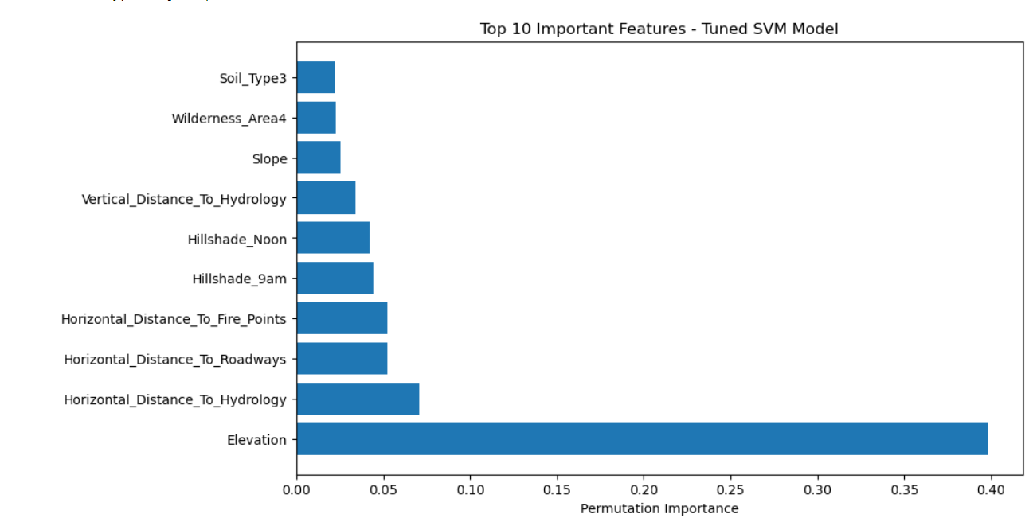

Slide 39
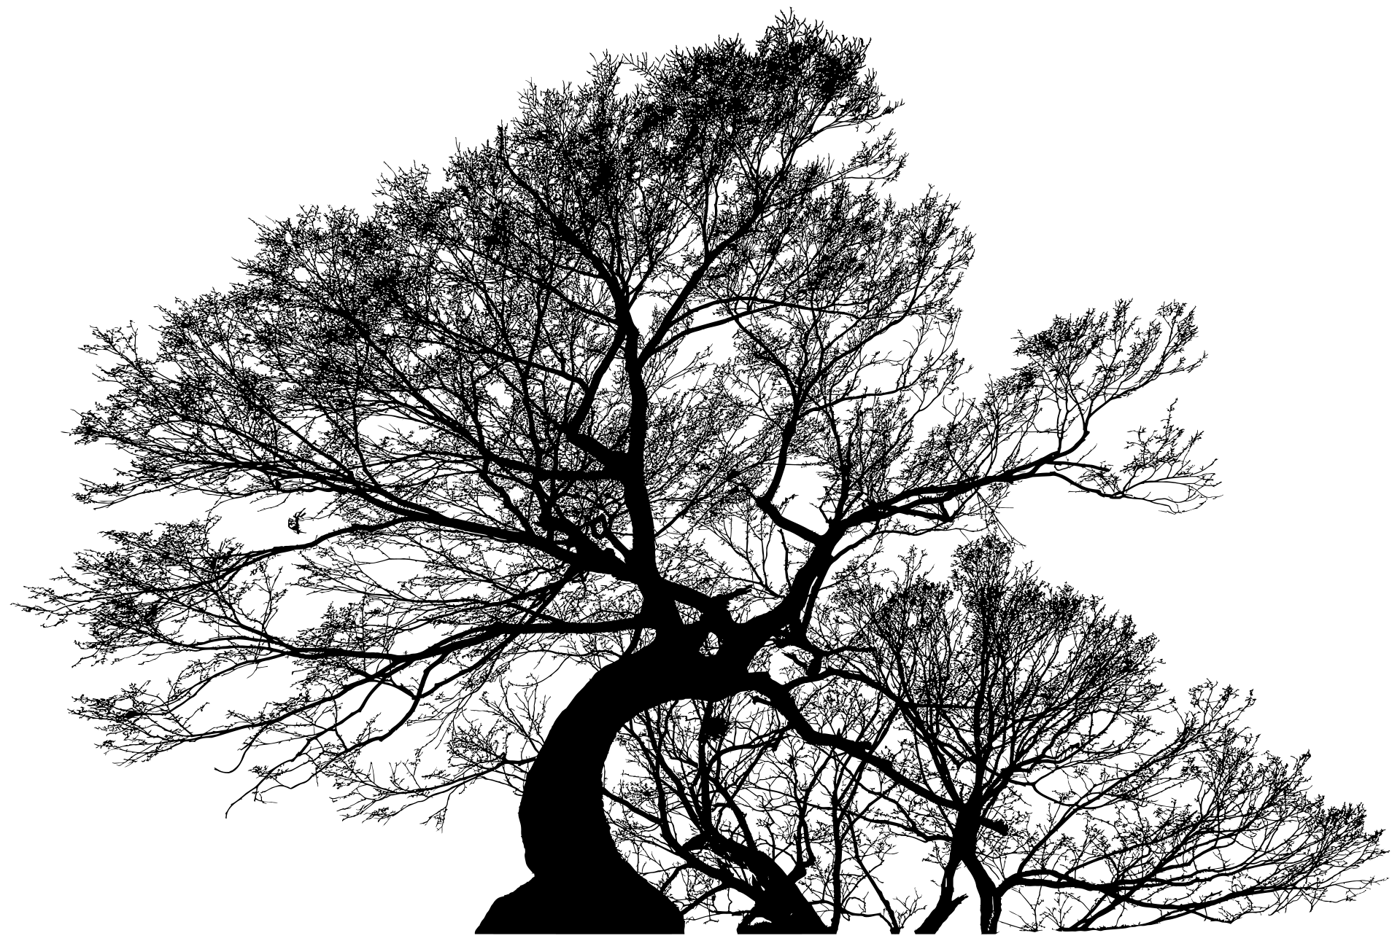
CONCLUSION
In conclusion, our project aimed at forest cover type prediction has led us to the development of a robust machine learning model. After an extensive exploration of various classifiers and tuning techniques, the Tuned Support vector machine emerged as our final model. This model, with an accuracy of 79.00%, strikes a balance between predictive performance and simplicity.
The Tuned Support vector machine not only demonstrated high accuracy on the testing set but also offers interpretability crucial for understanding feature importance in forest cover type prediction. Its capability to generalize well to new data, coupled with a reasonable drop in accuracy from training to testing, makes it a practical choice for real-world deployment.
This project showcases the significance of thoughtful model selection, hyperparameter tuning, and the trade-off between complexity and interpretability. The Tuned Support vector machine stands out as a reliable solution for forest cover type detection, with the potential for practical applications in environmental monitoring and conservation efforts.

Slide 40
REFERENCES
[1] D.J. Newman A. Asuncion. UCI machine learning
repository. https:
//archive.ics.uci.edu/ml/datasets/Covertype,
2007.
[2] Fr´ed´eric Bastien, Pascal Lamblin, Razvan Pascanu,
James Bergstra, Ian J. Goodfellow, Arnaud Bergeron,
Nicolas Bouchard, and Yoshua Bengio. Theano: new
features and speed improvements. Deep Learning and
Unsupervised Feature Learning NIPS 2012 Workshop,
2012.
[3] Christopher M. Bishop. Pattern Recognition and
Machine Learning (Information Science and Statistics).
Springer-Verlag New York, Inc., Secaucus, NJ, USA,
2006.

Slide 41
THANK YOU

